Slide 1
CMPE 521 Database Systems
QUERY SENSITIVE EMBEDDINGS
Vassilis Athitsos, Marios Hadjieleftheriou,
George Kollios and Stan Sclaroff
İDRİS YILDIZ
19.10.2005

Slide 2
Summary
General Information
Related Work
Required Background
Building Query Sensitive Embeddings
Evaluation of Method
Conclusion

Slide 3
General Information
Motivation of such a work
  Retrieve the most similar matches to a query object
  Nearest neighbor methods are used currently
  Existing solutions are too slow
  Especially in domains where objects are compared using computationally expensive similarity (or distance) measures
Method offered by the paper:
  A novel method for approximating nearest neighbor retrieval for object spaces with expensive distance measures
  Embedding based : Maps objects to real vector space while preserving the proximity structure of original space
  Query sensitive (distance measure change according to query) measures while finding distances

Slide 4
General Information (cont.)
Usage:
  Estimating the properties of a biological sequence (like a protein, or DNA sequence)
  Nearest neighbor classification used by pattern recognition techniques
For both cases a proximity measure is needed and this measure should be calculated easily.
Numerous methods have been proposed for speeding up nearest-neighbor retrieval but all are for metric spaces (coordinate space).
Metric spaces have fixed dimensions. In case of variable dimensions existing methods do not help
Query sensitive embeddings methods provide a way of nearest neighbor calculation for non-Euclidean (also non metric) spaces

Slide 5
General Information (cont.)
Method Summary
  Construct a function that maps objects into a real vector space
  Find query sensitive coefficients
  Measure the distance between objects by using the vector space calculated with L1 and L2 distances
  L1 or L2 over vectors should be more efficient than finding the original distance (usually holds)
The results obtained (details later)
  The proposed method gives better results according to the two well-known existing embedding methods: BoostMap and FastMap

Slide 6
Related Work
Hashing and tree structures
  Similarity indexing in multi-dimensional datasets
  The performance degrades in high dimensions
  Rely on Euclidean or metric properties, problem in non-metric spaces
Embedding based
  Lipschitz embeddings, FastMap, MetricMap, SparseMap, and BoostMap …
  Speed up nearest neighbor retrieval
  Construct an embedding, which maps objects into another space with a more efficient distance measure
BoostMap
  Preserves the original space proximity with original space (after the embedding)
  The proposed method is an extension to BoostMap

Slide 7
Required Background
Embeddings
Classifiers

Slide 8


Embeddings
1D Embeddings
  r is called the reference object
  D_{x} is the (non-metric) distance between x and r
  Project x into the line x₁x₂ (Building block for FastMap)
  1D Embeddings are considered weak classifiers (high error rate)
  1D embeddings can be used as building blocks for constructing higher-dimensional embeddings
Embedding Types:
  F^{x1,x2} is used to construct FastMap
  F^{r}s can be combined to form Lipschitz embeddings
  AdaBoost combines many weak classifiers into a strong classifier

Slide 9
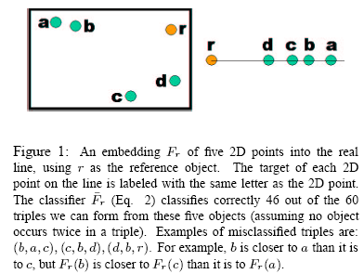
Embeddings (Cont.)

Slide 10
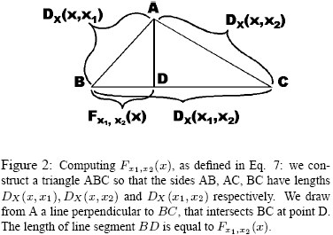
Embeddings (Cont.)

Slide 11
Classifiers
Weak Classifiers
  Given three objects q, a, b ∈ X, is q closer to a or to b?
  Find exact distances D_{x}(q,a) and D_{x}(q,b) !
  Find checking if F(q) is closer to F(a) or to F(b) where F is a d dimensional embedding F:X→R^{d}
  If the two methods stated above give the same result then F succeeds over (q,a,b) otherwise F fails over (q,a,b)
1D Embeddings act as weak classifiers because they have a high error rate
High dimensional Strong Classifiers can be built by using 1D Embeddings (Method of AdaBoost)
Purpose of weak classifiers : Reducing problem to find a strong classifier by using weak classifiers

Slide 12
Building Query Sensitive Embeddings
Motivation for constructing Query Sensitive Embeddings
Construction Method
Training Algorithm
Training Data

Slide 13
Motivation for constructing Query Sensitive Embeddings
Lack of contrasting: Two high-dimensional objects are unlikely to be very similar in all the dimensions.
Statistical sensitivity: The data is rarely distributed, and for a pair of objects there only relatively few coordinates that are significant for comparing those objects.
Query sensitive embeddings are required:
  Use weigths while finding distances
  Those weights will be query specific values

Slide 14
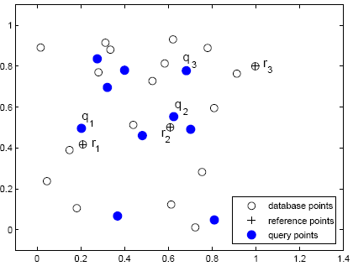
Query Sensitive Embedding Example

Slide 15
Query Sensitive Embedding (2)
F(x) = (F^{r1}(x), F^{r2}(x), F^{r3}(x))
L1 distance is used to compare the embeddings of two objects
20 database objects (3 reference points), 10 query objects
F fails on 23.5% of the 3800 triples (q, a, b) where q from query objects and a,b from database objects
1D embeddings F^{r1}, F^{r2}, F^{r3} fail respectively on 39.2%, 36.4%, and 26.6% of the triples

Slide 16
Query Sensitive Embedding (3)
If q = q₁ then for triples(q₁, a, b)
  F^{r1} does better than F
  F^{r1} fails on 5.8% of those triples
  F fails on 11.6% of those triples
Similarly if q = q2 and q = q3 respectively, F^{r2} and F^{r3} are more accurate than F.
For query objects q1, q2, q3 it would be beneficial to use a query-sensitive weighted L1 measure, that would respectively use only the first, second, and third coordinate of F

Slide 17
Construction Method
Specify a large family of 1D embeddings
Use 1D embeddings to define binary classifiers for estimating for object triples (q, a, b) if q is closer to a or to b.
  These classifiers are expected to be better than a random classifier
Run AdaBoost to combine many classifiers into a single classifier (H)
  H is significantly more accurate than the simple classifiers associated with 1D embeddings
Use H to define a d-dimensional embedding F_{out}, and a query-sensitive weighted L1 distance measure D_{out}
  H is equivalent to the combination of F_{out} and D_{out}
  For three objects q, a, b ∈ X, H predicts that q is closer to a than it is to b, then F_{out}(q) is closer to F_{out}(a) than it is to F_{out}(b)

Slide 18



Construction Method (cont.)
The classifier:
  1 ➔ if q is closer to a
  -1 ➔ if q is closer to b
  -1 ➔ if q is in equal distance (D type) to a,b
  Classifier may fail if the reference is outside a region of the objects ➔use Splitters
The splitter (0,1):
  V is a specified region or a threhold
The Query Sensitive Classifer is combination of classifer and the splitter:

Slide 19
Training Algorithm
Usage: Constructing an embedding and a query sensitive distance measure
AdaBoost algortihm is used as the training algortihm
  AdaBoost assumes that we have a “weak learner” module, which we can call at each round to obtain a new weak classifier.
  The goal is to construct a strong classifier that achieves much higher accuracy than the individual weak classifiers.
  At each step algorithm simply determines the appropriate weight for each weak classifier, and then adjusts the training weights
  At each round mistakes from previous rounds are corected by some amount
Some changes and additions are done on the to adapt AdaBoost to this case

Slide 20
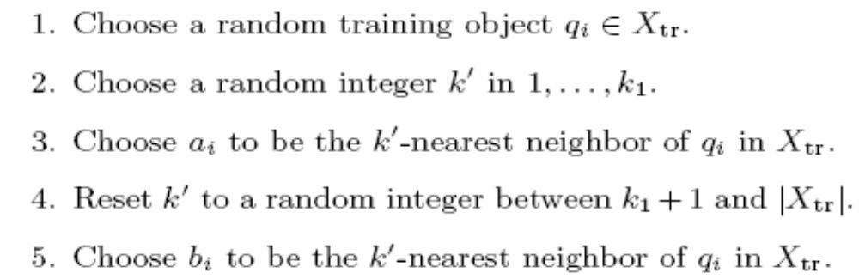
Training Data
X_{tr} is a subset of X (object space)
We need to compute D_{x} for all pairs of points in X_{tr}

Slide 21
Evaluation of Method
Complexity Analysis
Embedding application: filter and refine retrieval
Experiments

Slide 22
Complexity Analysis
At each training round measure m classifiers with t training triples in order to choose the best weak classifier
  The computational time per training round is O(mt)
Before we even start the training algorithm, we need to compute distances D_{x} from:
  Every object in C to every object in C
  Every object in C to every object in X_{tr}
  C ➔ the set of objects that we use to form 1D embeddings
  X_{tr} ➔ the set of objects from which we form training triples
We also need all distances between pairs of objects in X_{tr}
Computing all those distances can sometimes be the most computationally expensive part of the algorithm, depending on the complexity of computing D_{x}
Fortunately all those costs are just onetime preprocessing costs

Slide 23
Complexity Analysis (cont.)
Computing the d-dimensional embedding of a query object takes O(d) time
Also it requires O(d) evaluations of D_{x}
Result ➔ Comparing the embedding of the query to the embeddings of n database objects takes time O(dn)
For a fixed d, these costs are similar to FastMap, SparseMap, and MetricMap
Incase of dynamic data change no performance penalty will be required until the underlying database structure changes (after too many inserts and deletions)

Slide 24
Embedding application: filter and refine retrieval
In applications where we are interested in retrieving the k nearest neighbors for a query object q, a d-dimensional embedding F can be used in a filter-and-refine framework
  Compute and store vector F(x) for every database object x (offline step)
For any new query q perform following:
  Embedding step: compute F(q), by measuring the distances between q and the reference objects and/or pivot objects used to define F
  Filter step: Find the database objects whose associated vectors are the p most similar vectors to F(q)
  Refine step: sort those p candidates by evaluating the exact distance D_{X} between q and each candidate
The filter step discards most database objects by measuring distances between vectors
The refine step applies D_{x} only to the top p candidates

Slide 25
Experiments
Comparison of the proposed method to the original BoostMap method and FastMap will be done
We used two different datasets: the MNIST and a time series dataset
MNIST:
  Dataset of handwritten digits (from 0 to 9)
  Shape Context Distance as the exact distance measure
  A training set of 60,000 image
Time Series:
  Dynamic Time Warping as the exact distance measure
  32,768 various sequences are obtained
Both Shape Context Distance and Dynamic Time Warping are very hard to compute

Slide 26
Experiments (Cont)
Parameter “k” will be used in experiments as the number of k-neighbor.
Algorithms:
  FastMap
  Ra-QI ➔ Original BoostMap
  Se-QS ➔ Proposed Method
  Se-QI ➔ Intermediate method (which incorporates our method of choosing training triples, but still constructs a query-insensitive embedding)
We will try to achieve all k-neighbours with minimum number of comparisons

Slide 27
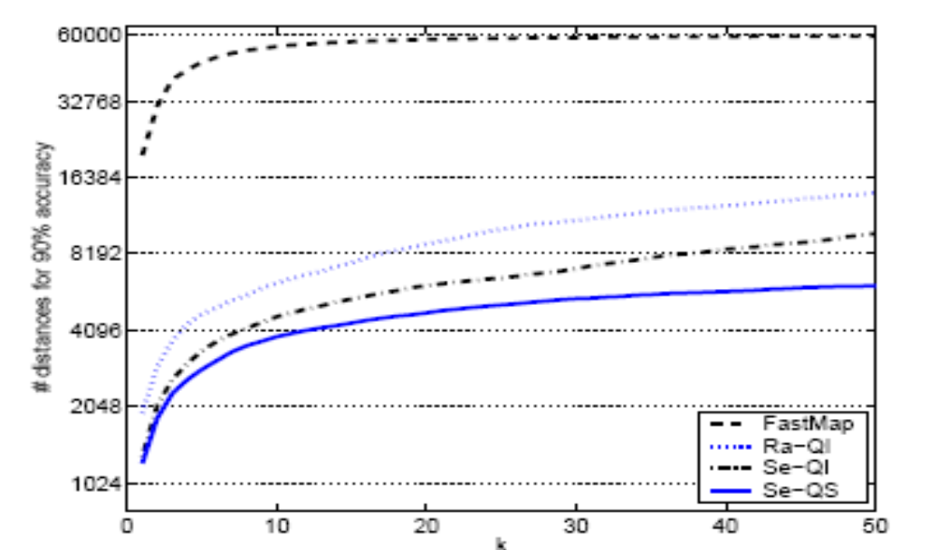
Experiments (MNIST- %90 accuracy)

Slide 28
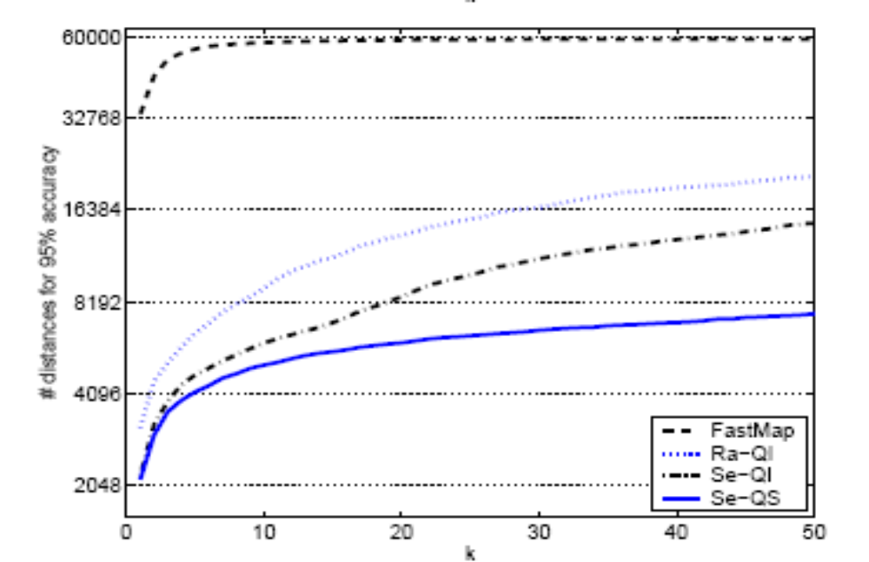
Experiments (MNIST- %95 accuracy)

Slide 29
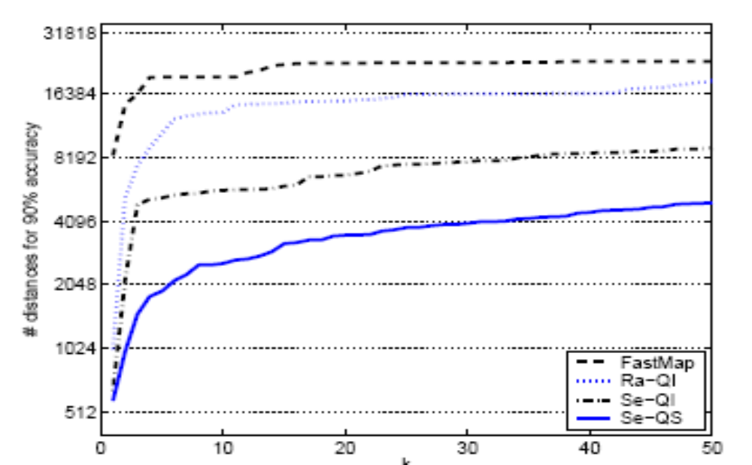
Experiments (Time Serials- %90 accuracy)

Slide 30
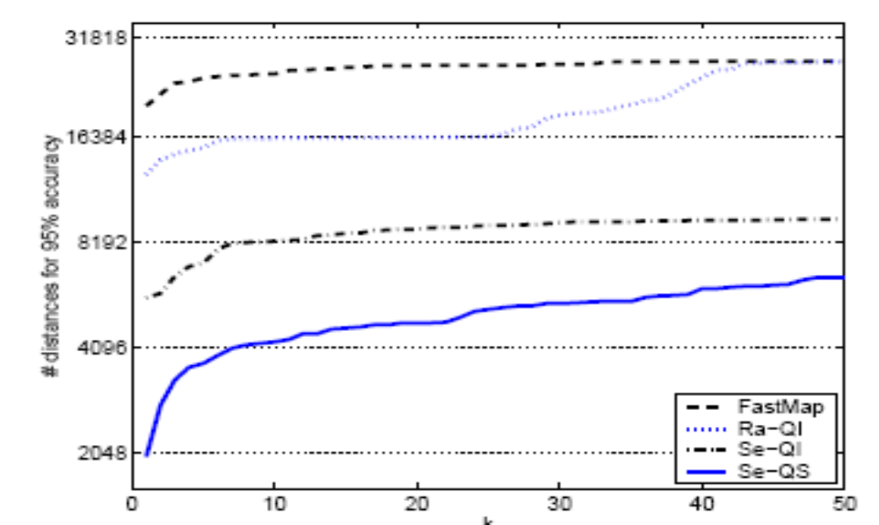
Experiments (Time Serials- %95 accuracy)

Slide 31
Conclusion
The main difference of the proposed method with respect to existing embedding methods is that it constructs a query sensitive distance measure
Such a distance measure captures the fact that different embedding coordinates are important for different queries, and thus leads to improved retrieval accuracy and speed by using smaller number of comparisions
Embeddings is a family of methods that is not domain specific and can be applied for efficient retrieval in non-metric spaces

Slide 32
Thanks...

